Slide 1
relational Model
Mohamed Wael Gharbi

Slide 2
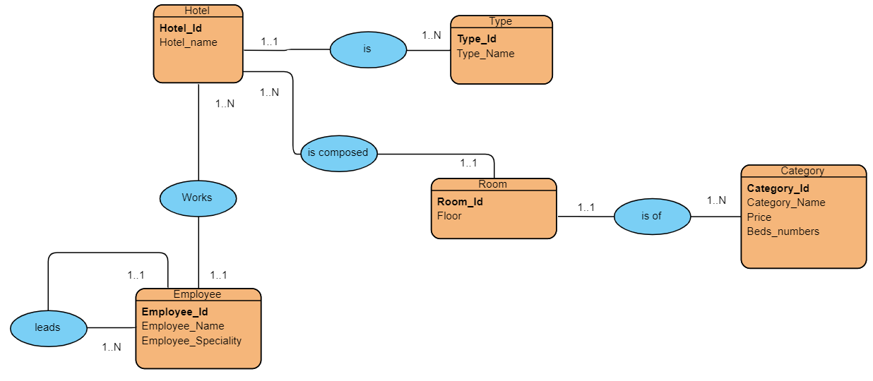

Slide 3
Employee(Employee_id, Employee_name , Employee_speciality,#Hotel_id , #Director_id);
Hotel(Hotel_id,Hotel_name,#Type_id );
Type(Type_id ,Type_Name);
Room(Room_id,Floor, #Hotel_id , #Category_id);
Category(Category_id,Category_name,Price , Beds_numbers)

